Slide 1
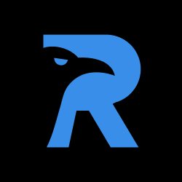
RAVENDB
Presented by :CB.SC.U4CSE25745
CB.SC.U4CSE25726
Course : Database Management Systems

Slide 2
INTRODUCTION
RavenDB is an open-source, NoSQL document database designed to store, manage, and retrieve data efficiently
Unlike relational databases such as MySQL, which organize data primarily into tables and rows, RavenDB stores information as JSON documents.
It supports document-based data modeling, indexing, querying, transactions, and replication across multiple servers.

Slide 3
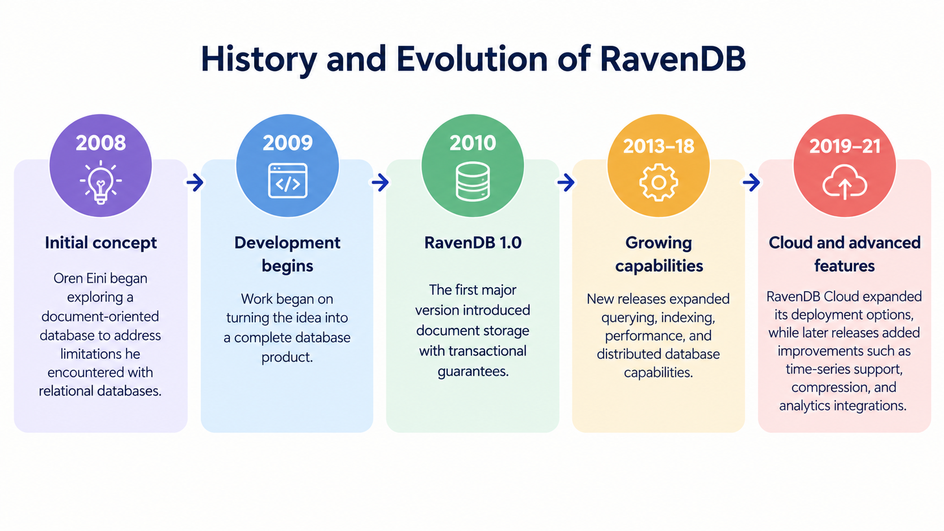

Slide 4
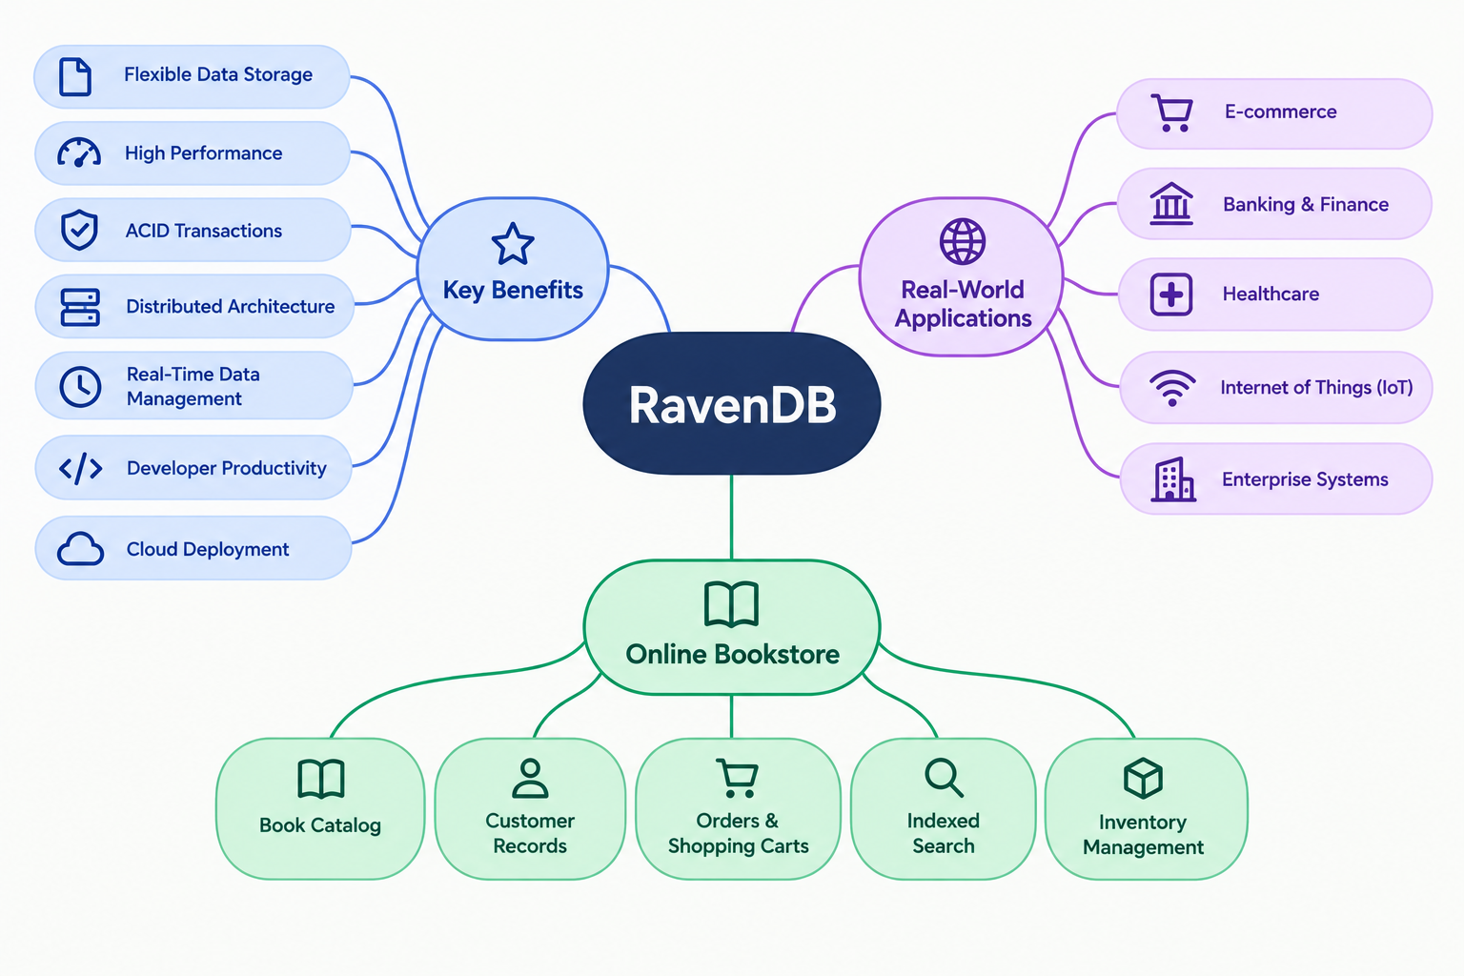

Slide 5
Database Type & Model
TYPE: NoSQL database
CATEGORY:Document-Oriented Database
Database model: Non-relational, schema-flexible model.
Storage format: JSON-based documents.
Suitability:
Modern web applications, e-commerce platforms, content management systems, and distributed business applications.
Ex:
{
"Id": "books/101",
"Title": "Database Systems",
"Author": "Thomas Connolly",
"Price": 650,
"Category": "Computer Science"
}

Slide 6
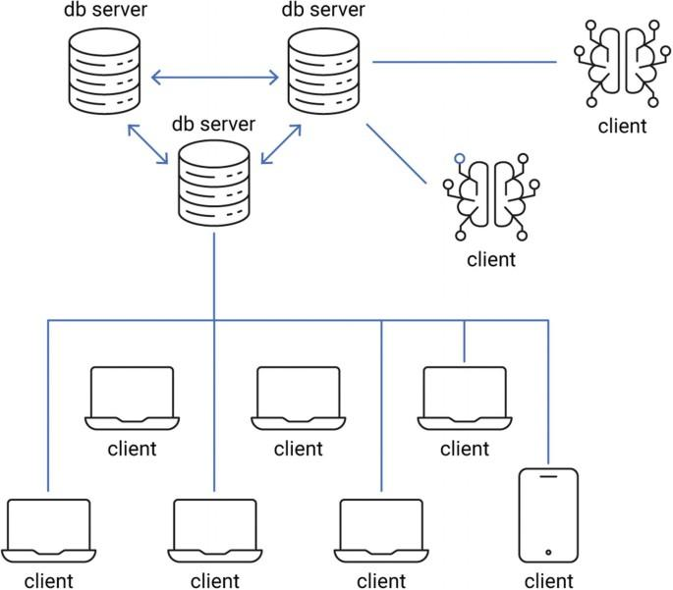
SYSTEM ARCHITECTURE

Slide 7
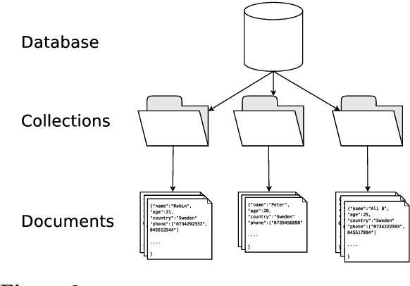
STORAGE MANAGEMENT

Slide 8
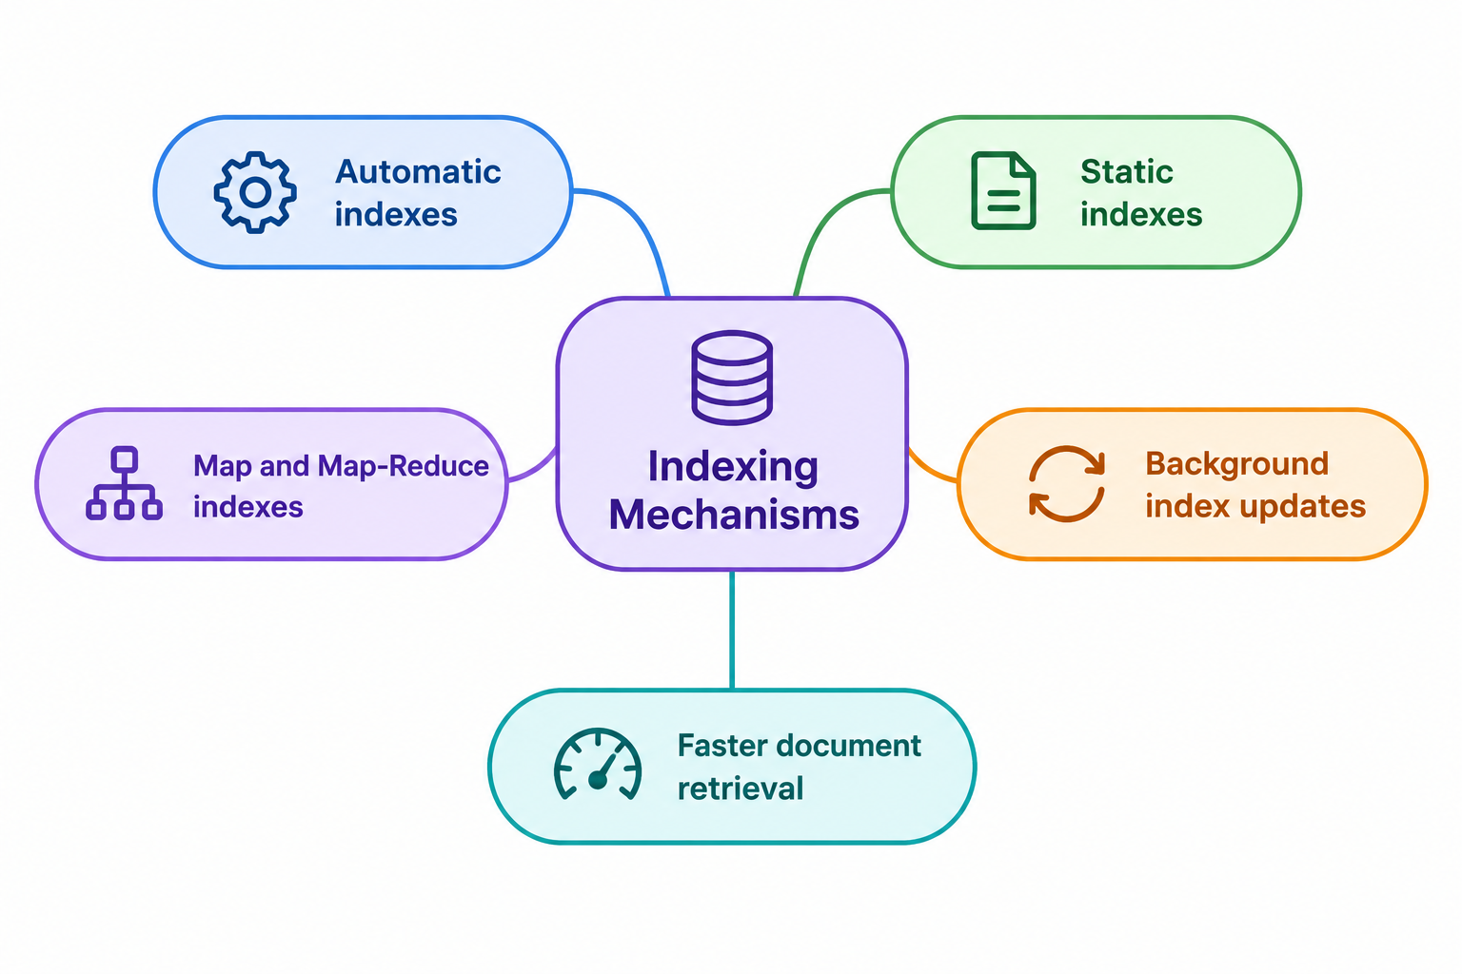
INDEXING MECHANISMS

Slide 9
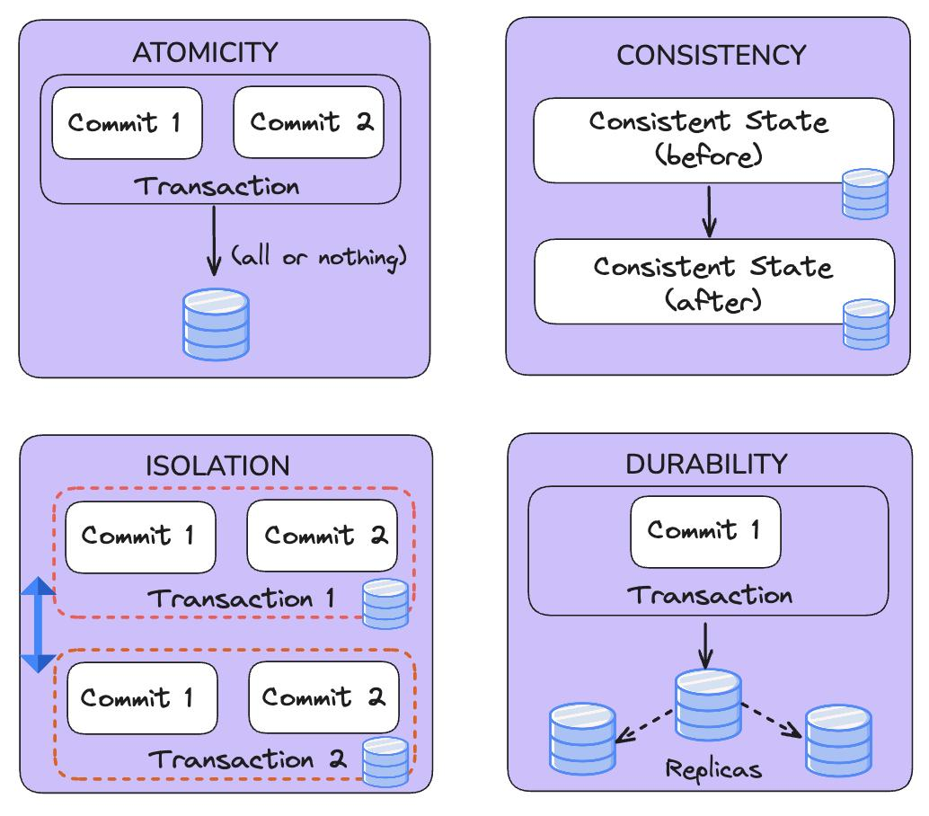
TRANSACTIONS AND CONCURRENCY

Slide 10
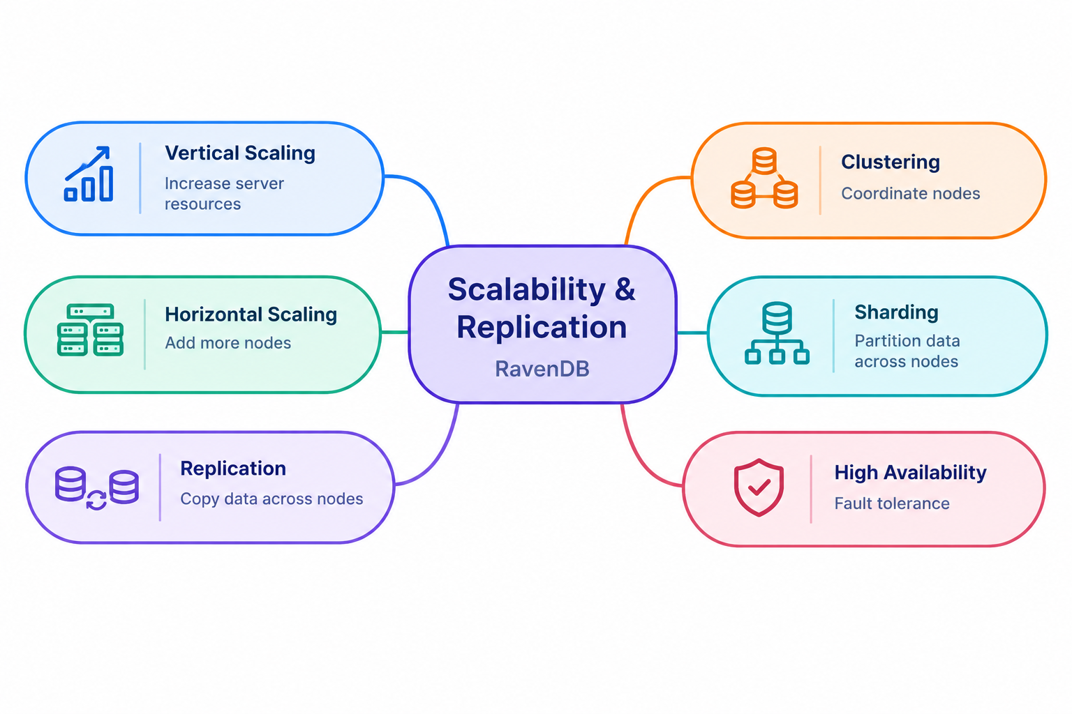

Slide 11
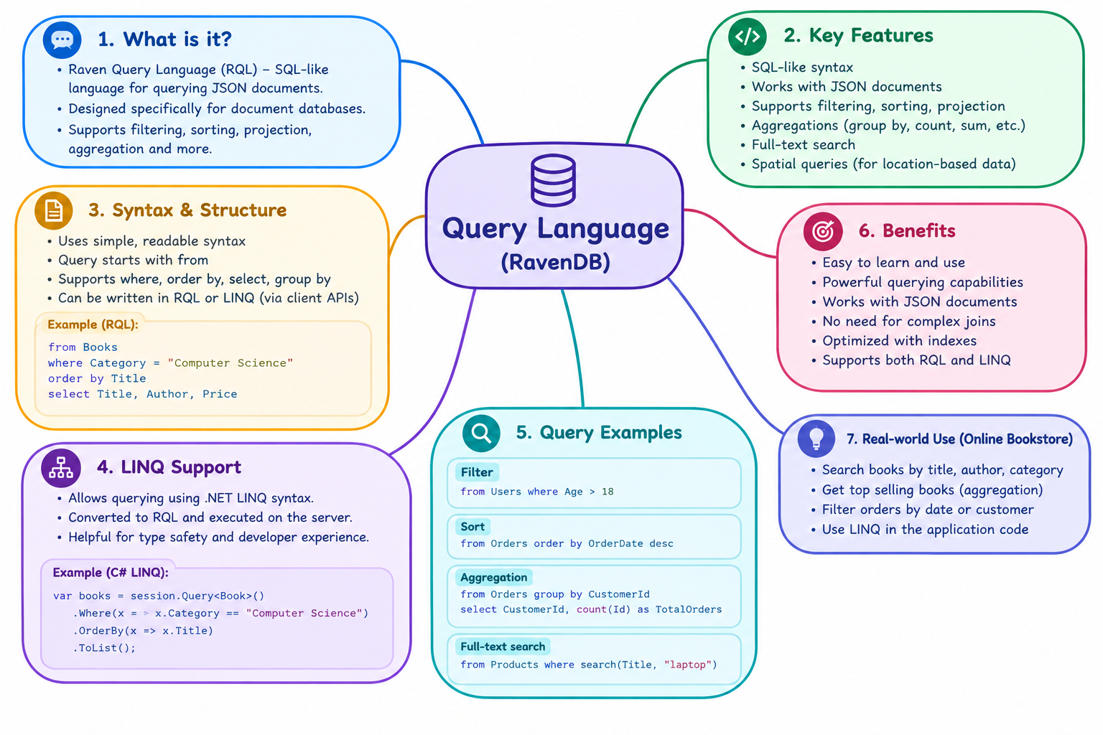
QUERY LANGUAGE

Slide 12
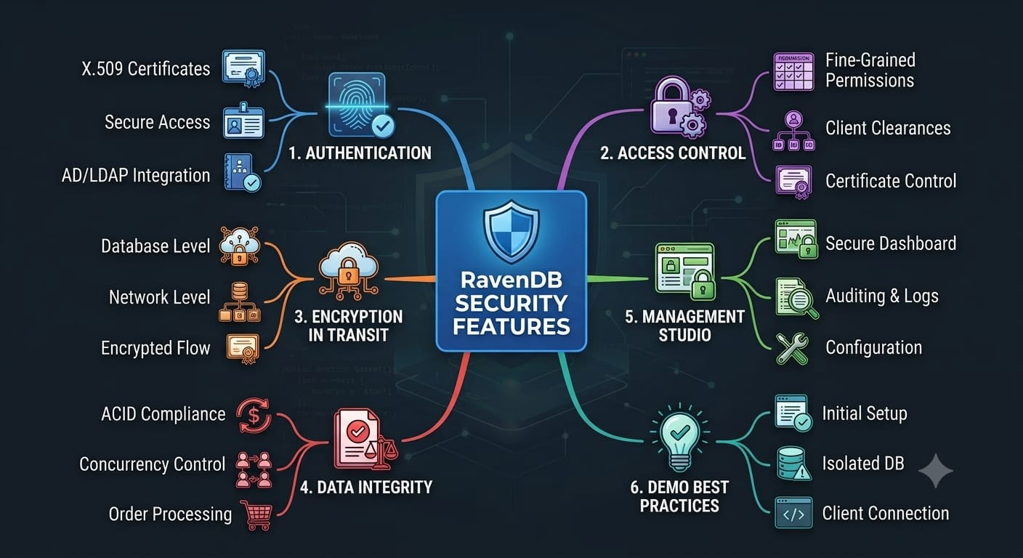

Slide 13
DATA INTEGRITY CONSTRAINTS
ACID Transactions: Ensures order creation and inventory updates happen together or fail together.
​Concurrency Control: Prevents race conditions and overselling stock during simultaneous orders.
​Document Validation: Maintains strict document schemas and consistent data states across the database.

Slide 14
INTGERATION WITH OTHER TOOLS
Modern Stack SDKs: Native client support for .NET Core / C#, Node.js, Python, Java, and Go.
​API Connectivity: RESTful HTTP API and LINQ support for seamless data operations.
​Cloud & Tools: Works out of the box with cloud environments (AWS, Azure) and external analytics tools.

Slide 15
ADVANCED FEATURES
Subscriptions: Server-side event streaming that automatically triggers actions on document updates.
​Map-Reduce Indexes: Aggregates and pre-computes complex analytical queries directly on the server.
​Server-Side Scripts: Allows embedded JavaScript execution for batch updates and data transformations.

Slide 16
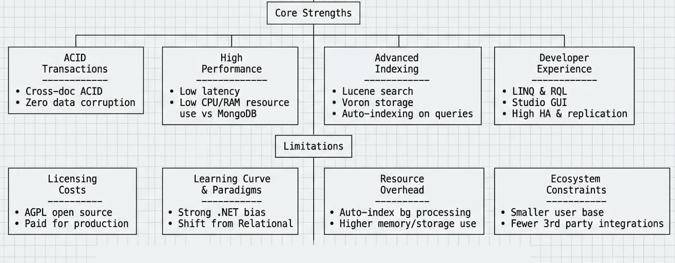
STRENGTHS AND LIMITATIONS

Slide 17
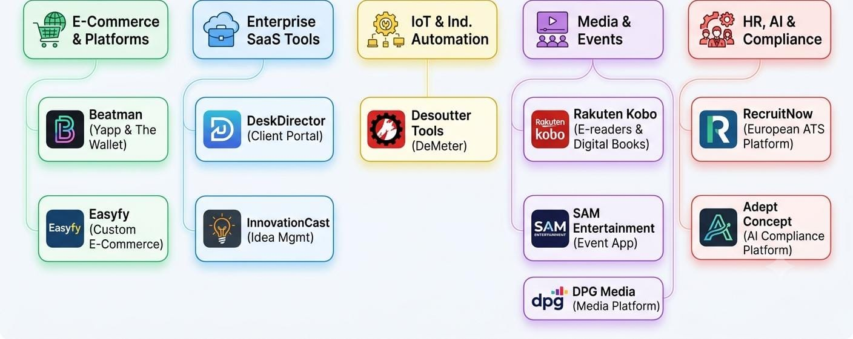
ORGANIZATIONS AND PRODUCTS USING RAVENDB

Slide 18
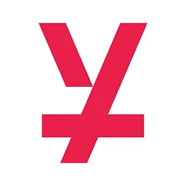
BEATMAN YAPP’S SUCCESS STORY WITH RAVEN DB
Application: Yapp marketplace and social platform; The Wallet.
Database: RavenDB document database.
Scale: 20M+ documents, 120 GB of data, approximately 1 million requests/day.
Architecture: Three-node RavenDB cluster.
Features Used: ACID transactions, indexing, full-text search, subscriptions, document revisions.
Benefits: Flexible data storage, efficient search, reliable transactions, simplified database management.
Outcome: Supported large-scale marketplace operations and growing application workloads.

Slide 19
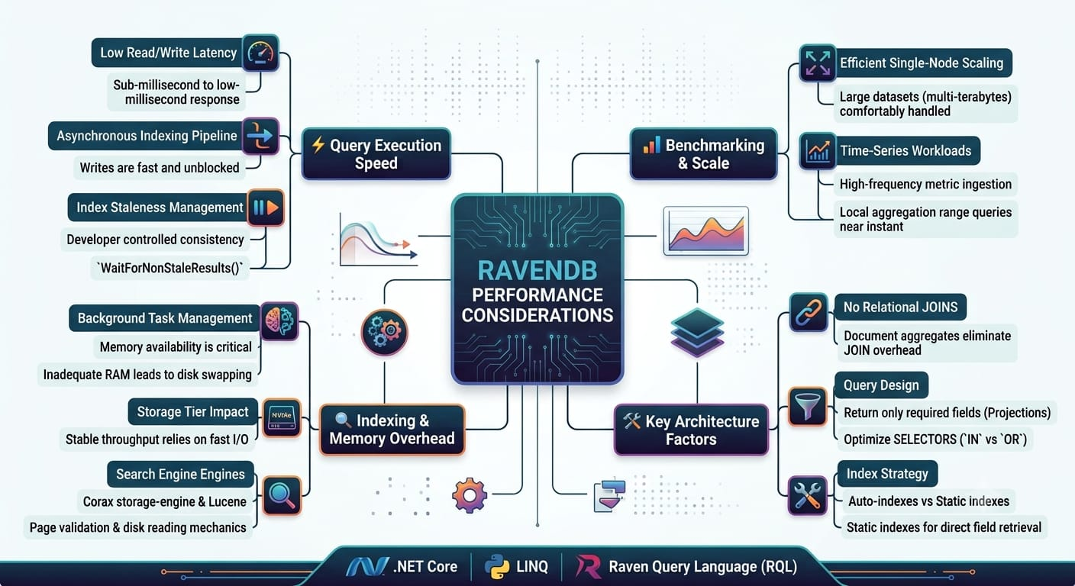

Slide 20
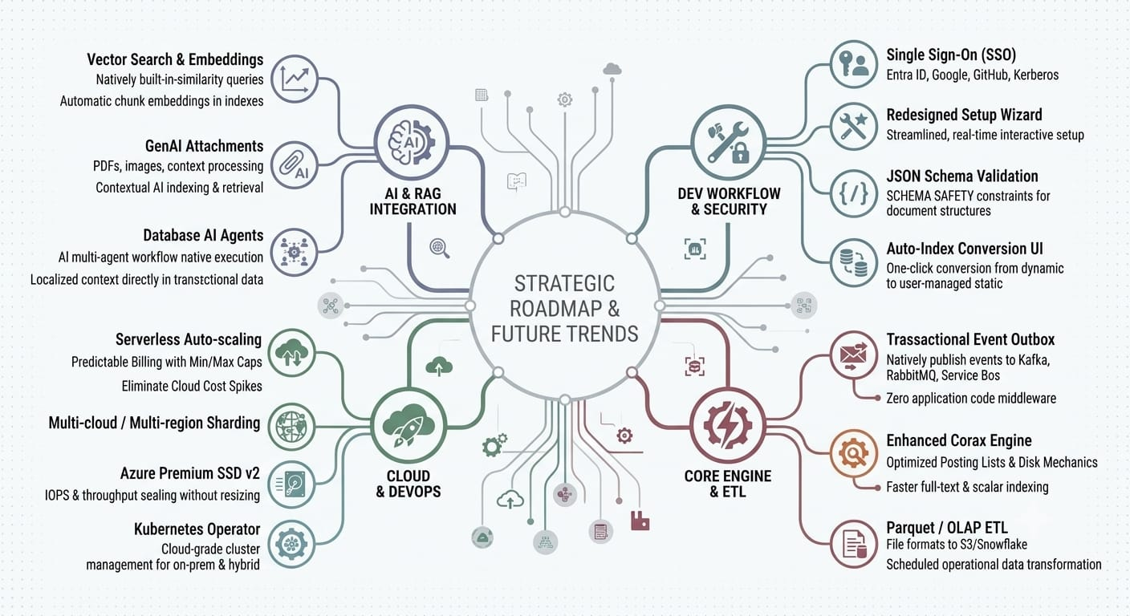

Slide 21
References
RavenDB. RavenDB Documentation — Documents and Collections. https://docs.ravendb.net/7.2/studio/database/documents/documents-and-collections
RavenDB. Query Overview. https://docs.ravendb.net/7.2/querying/overview
RavenDB. Sharding Overview. https://docs.ravendb.net/7.0/sharding/overview
RavenDB. Security Overview. https://docs.ravendb.net/7.2/server/security/overview
RavenDB. Sharding: Backup and Restore. https://docs.ravendb.net/7.2/sharding/backup-and-restore/backup
RavenDB. Beatman’s Decade of Success with RavenDB. https://www.ravendb.net/use-cases/beatmans-decade-of-success-with-ravendb
RavenDB. RavenDB Features. https://www.ravendb.net/features

